Slide 1

Applications of Artificial Intelligence
Master. Cesar Sinchiguano
Robotics and Cybernetics

Slide 2
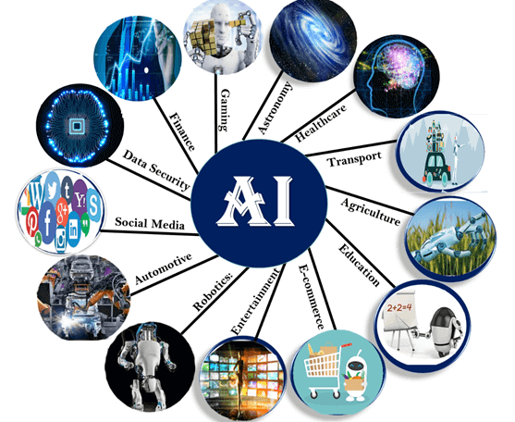
Today’s lecture
Conventional programming vs ML
What is Artificial Intelligence?
AI In Marketing
AI In Banking
AI In Finance
AI In Agriculture
AI In HealthCare
AI In Gaming
AI In Space Exploration
AI In Autonomous Vehicles
AI In Chatbots

Slide 3
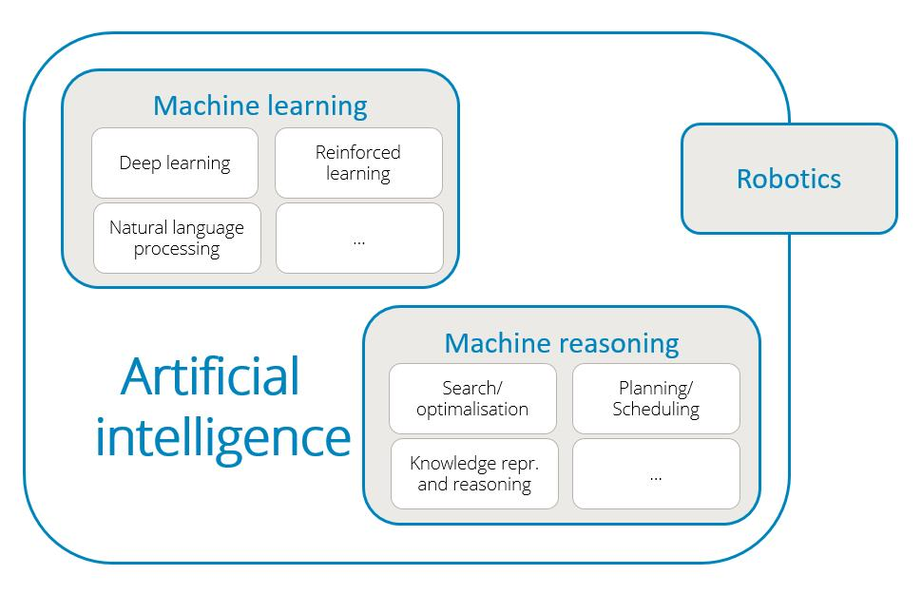

Slide 4
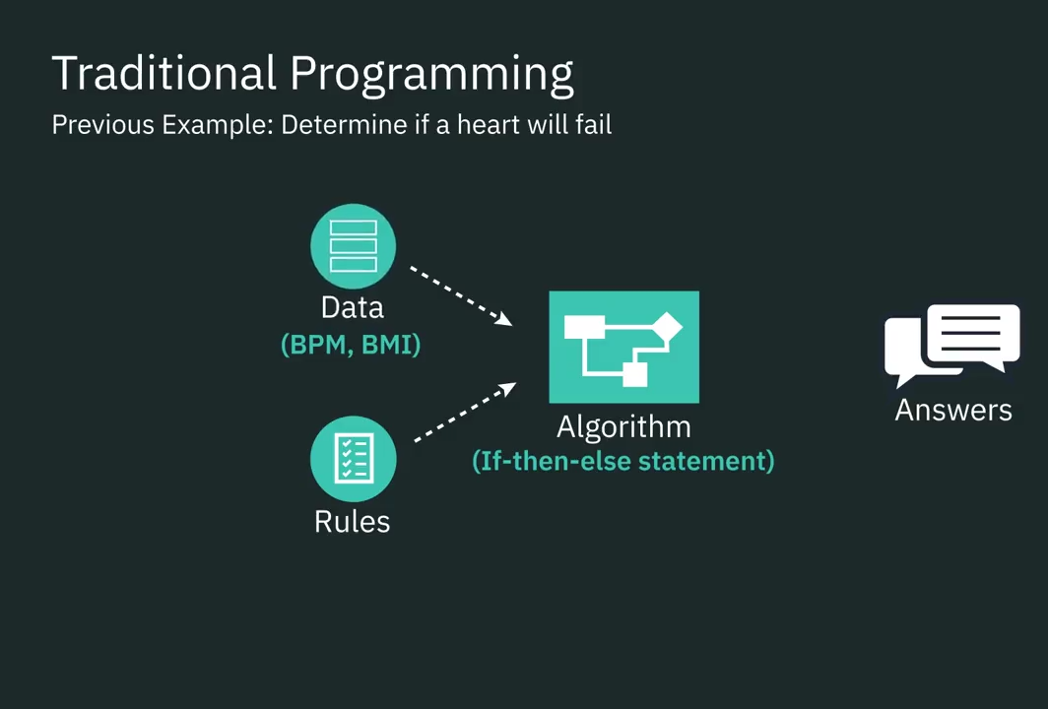
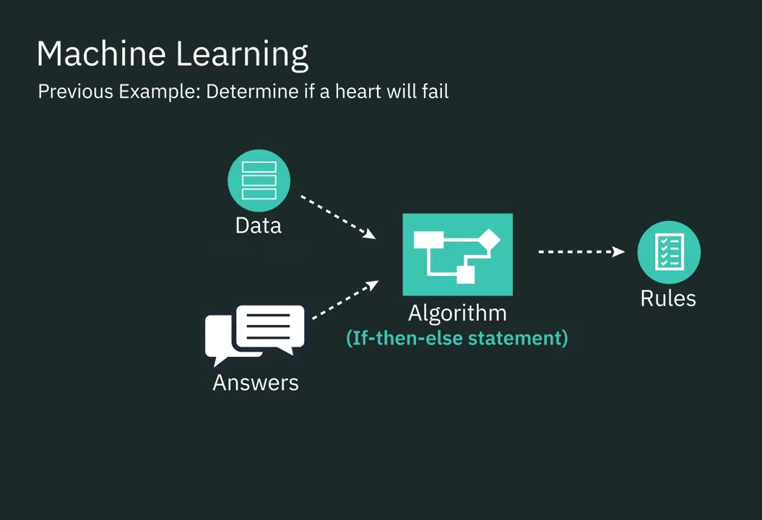
Conventional programming vs machine learning

Slide 5
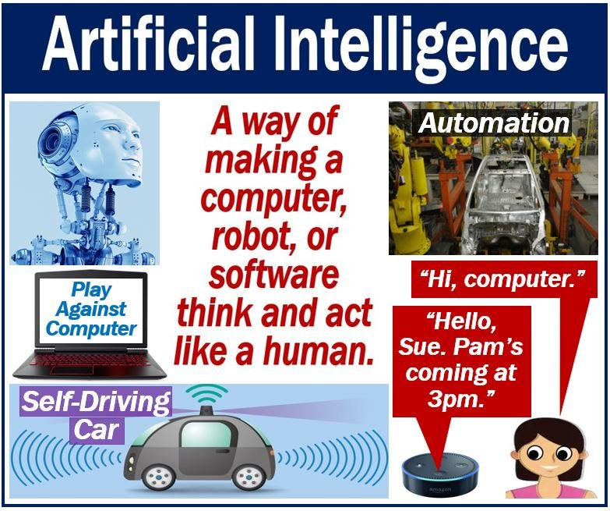
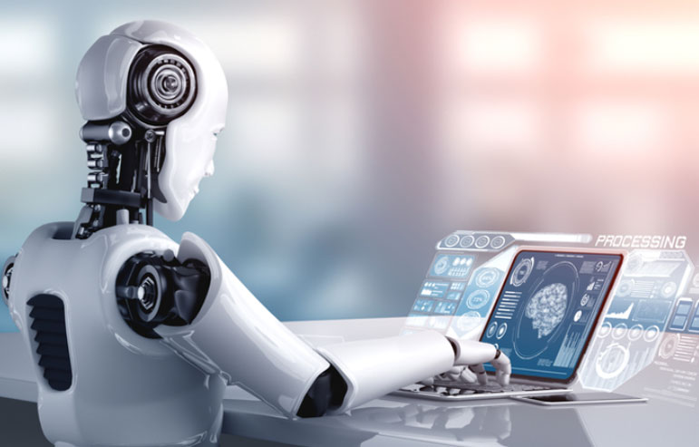
What is Artificial Intelligence?
AI is a method of programming a computer, robot, or other object to think like a smart human.
AI is the study of how the human brain thinks, learns, makes decisions, and works to solve problems.
In simple words
Artificial Intelligence is made up of the phrases Artificial and Intelligence, with Artificial referring to “man-made” and Intelligence referring to “thinking power,” so AI refers to “a man-made thinking power.”
Cognitive: relating to the processes of thinking and reasoning

Slide 6


Artificial Intelligence Applications: Marketing
Marketing is a way to sugar coat your products to attract more customers.
Before, we searched an online store to find a product without knowing its exact name, it was a nightmare to find the product.
Now, we search for an item on any e-commerce store, we get all possible results. It’s like these search engines are reading our minds!
In a matter of seconds, we get a list of all relevant items. An example of this is finding the right movies on Netflix.
One reason why we’re all obsessed with Netflix. It examines millions of records to suggest movies that you might like based on your previous actions and choices of films.
As the data set grows, this technology is getting smarter and smarter every day.
Sugarcoat: to make something seem more positive or pleasant than it really is

Slide 7
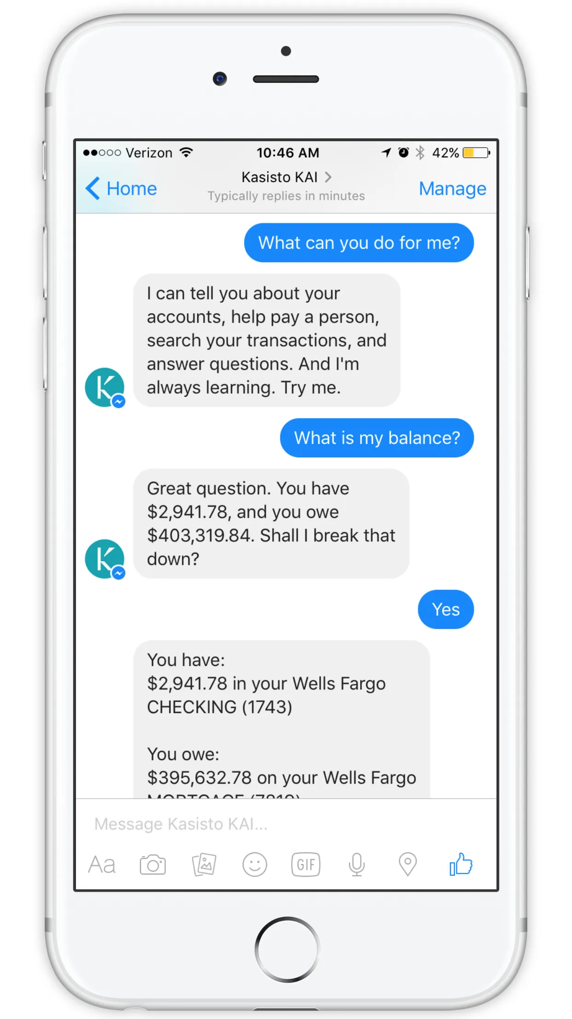
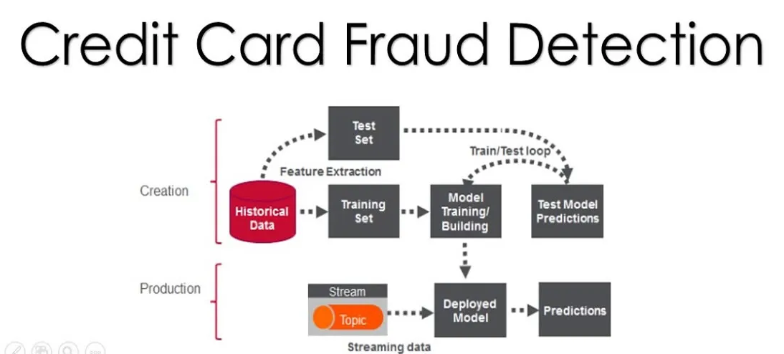
Artificial Intelligence Applications: Banking
HDFC Bank.
AI in banking is growing faster than you thought!
A lot of banks have already adopted AI-based systems to provide
Customer support,
Detect anomalies
Credit card frauds.
Companies such as MasterCard and RBS WorldPay have relied on AI and Deep Learning to detect fraudulent transaction patterns and prevent card fraud for years now. This has saved millions of dollars.

Slide 8
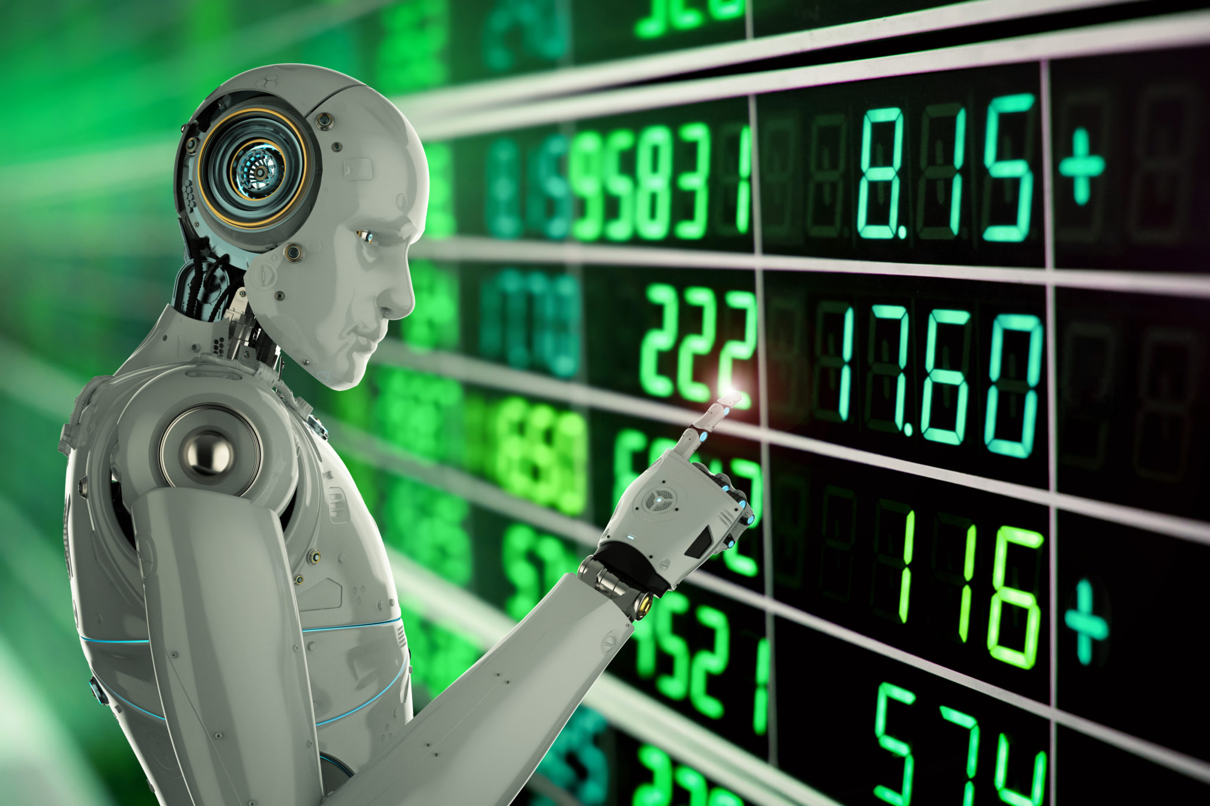
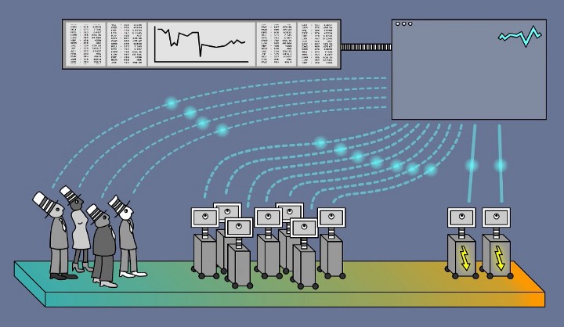
Artificial Intelligence Applications: Finance
Ventures have been relying on computers and data scientists to determine future patterns in the market.
Trading mainly depends on the ability to predict the future accurately.
Machines are great at this because they can crunch a huge amount of data in a short span
Machines can also learn to observe patterns in past data and predict how these patterns might repeat in the future.
Left traders, Center ” common machine trading systems, Right HFT high frequency trading (ML)

Slide 9
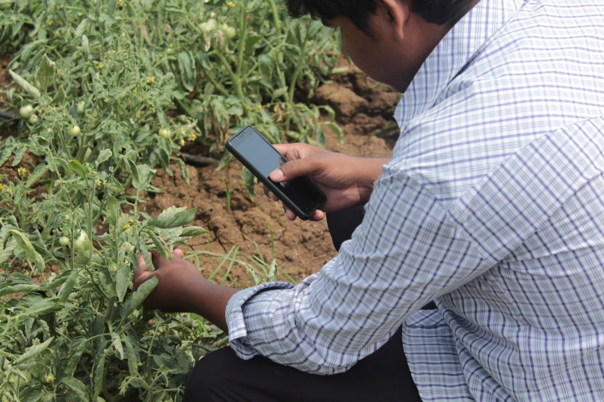
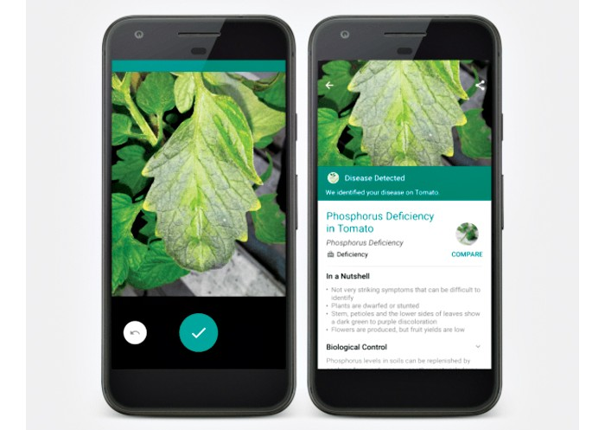
Artificial Intelligence Applications: In Agriculture
Plantix - a mobile app revolutionizes farming with a little help from AI
Plantix was developed by PEAT GmbH, a Berlin-based AI startup.
The app claims to diagnose pest damages, plant diseases and nutrient deficiencies affecting crops and offers corresponding treatment measures.
See&Spray

Slide 10


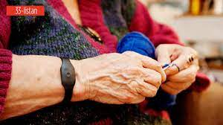
Artificial Intelligence Applications: In HealthCare
AI applications are used in healthcare to build sophisticated machines that can detect diseases and identify cancer cells.
Coala life which is a company that has a digitalized device that can find cardiac diseases.
Aifloo is developing a system for keeping track of how people are doing in home care.
The best thing about AI in healthcare is that you don’t even need to develop a new medication. Just by using an existing medication in the right way, you can also save lives.
heartMonitor
aifloo
RoboticSurgery

Slide 11
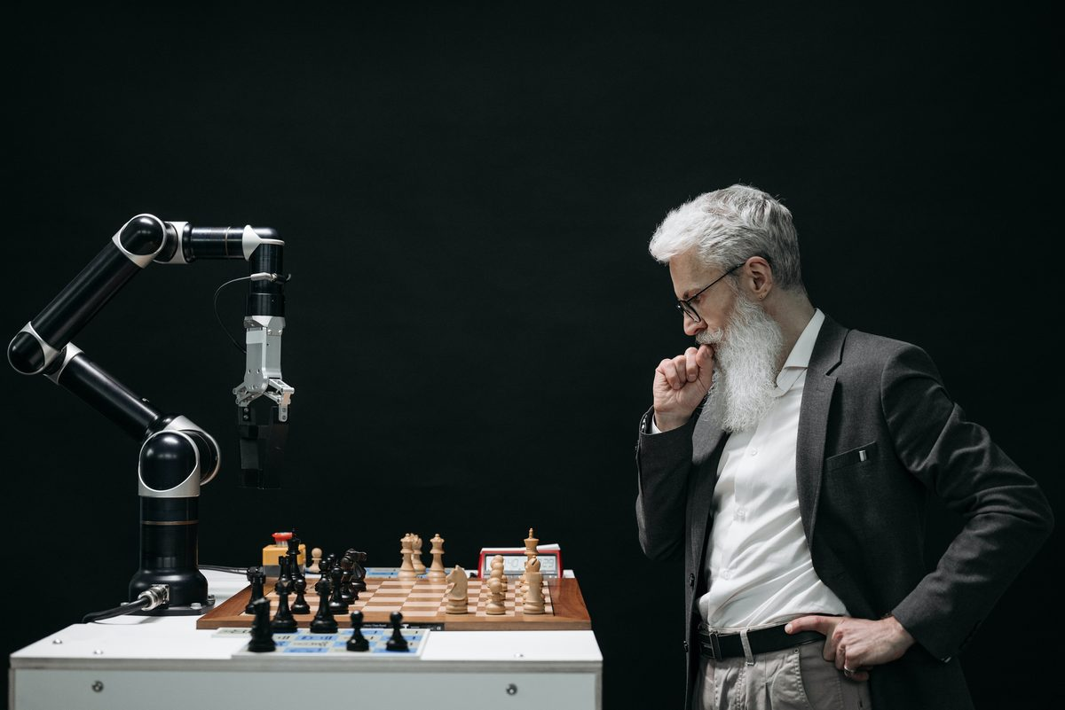
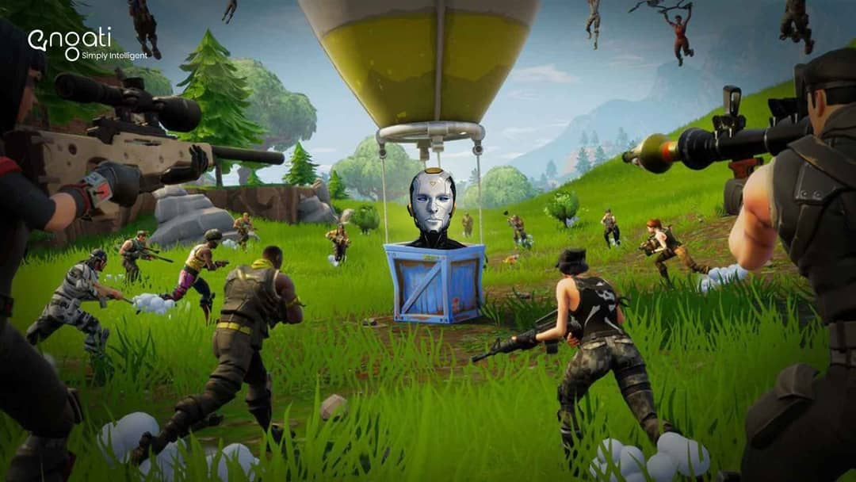
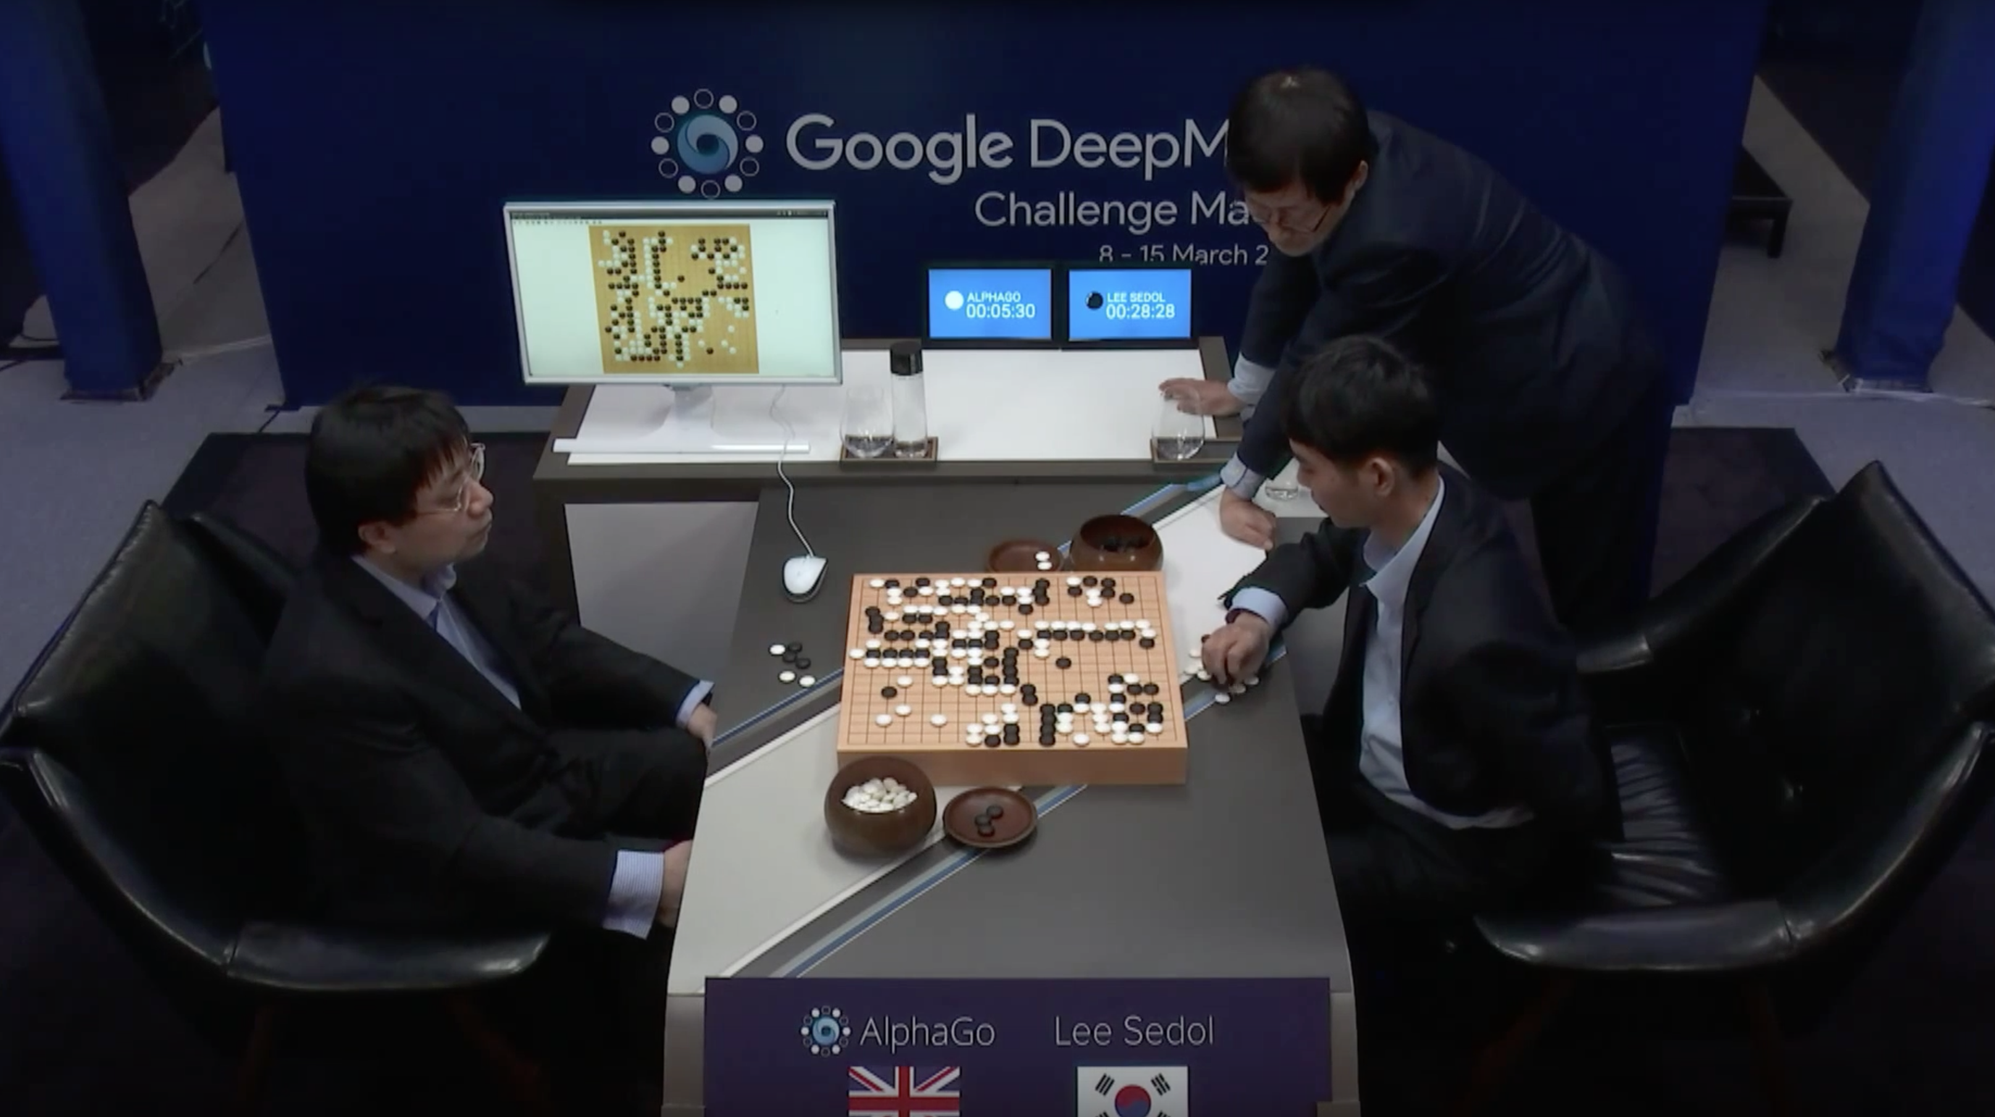
Artificial Intelligence Applications: Gaming
Another sector where Artificial Intelligence applications have found prominence is the gaming sector.
AI can be used to create smart, human-like NPCs to interact with the players.
AI in gaming refers to responsive and adaptive video game experiences.
These AI-powered interactive experiences are usually generated via non-player characters, or NPCs, that act intelligently or creatively, as if controlled by a human game-player.
Deep Blue was a chess-playing expert system run on a unique purpose-built IBM supercomputer.
Go is a game invented thousands of years ago in China and has evolved into one of the most complex and sophisticated games in the world.
The Go community was devastated when DeepMind‘s AlphaGo defeated Lee Sedol in four out of five matches.
By defeating the next four best players on Earth, AlphaGo demonstrated to everyone that AI is superior to humans in the game.
NPCs, or non-player characters, are the characters in a game that are controlled by the game itself, rather than by the player.
GamingAI
infGames

Slide 12
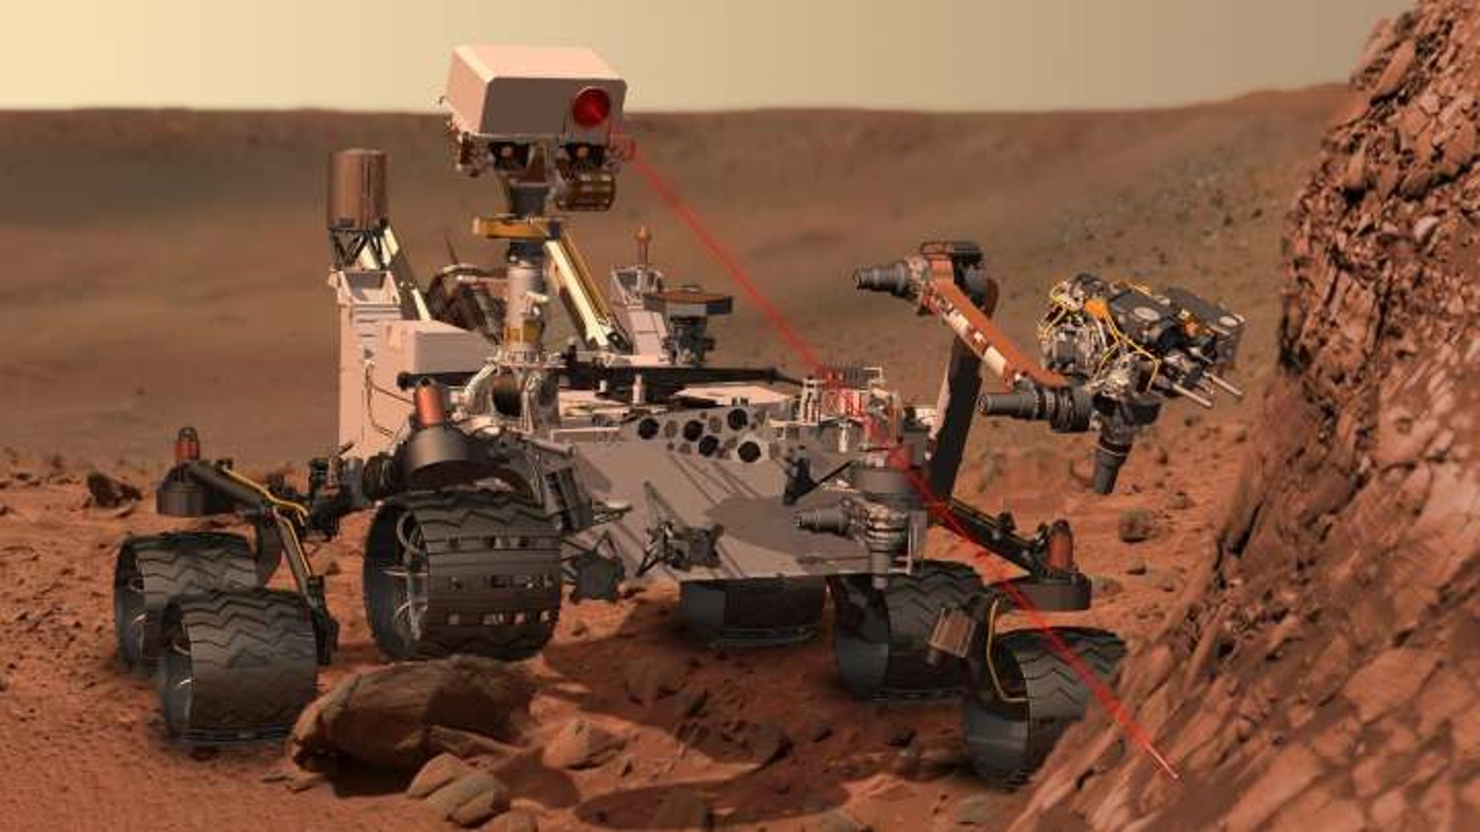
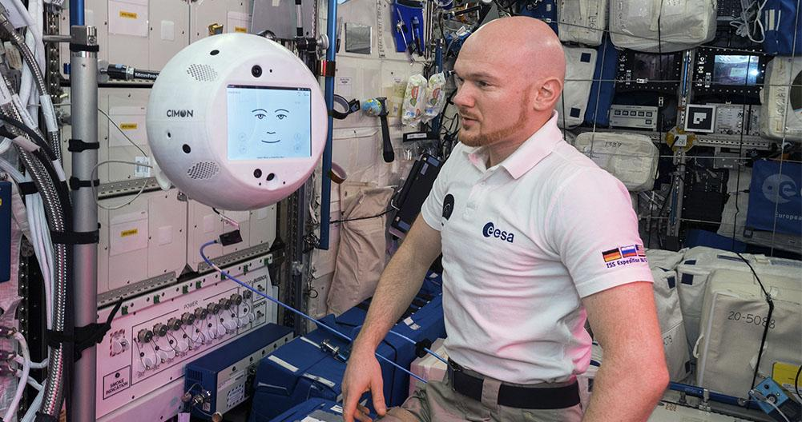
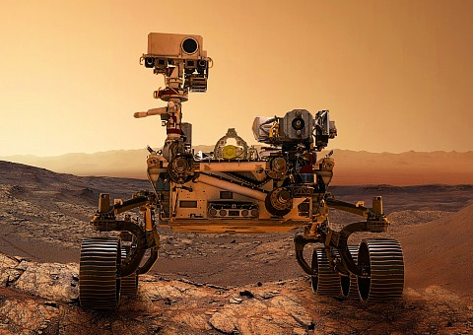
Artificial Intelligence Applications: Space Exploration
Space expeditions and discoveries always require analyzing vast amounts of data.
Artificial Intelligence and Machine learning is the best way to handle and process data on this scale.
Many companies, such as NASA, the European Space Agency (ESA) and SpaceX, are already using AI as a way to improve exploration, find new celestial objects and improve astronauts’ lives in space.
Robonaut is a dexterous humanoid robot designed to expand NASA’s ability for construction and discovery
AUTONOMOUS ROVERS
Dexterous: having the ability to perform a difficult action quickly and skilfully with the hands
IMAGE ANALYSIS AUTOMATION
Cimon
roverNasa
INTELLIGENT NAVIGATION SYSTEM

Slide 13
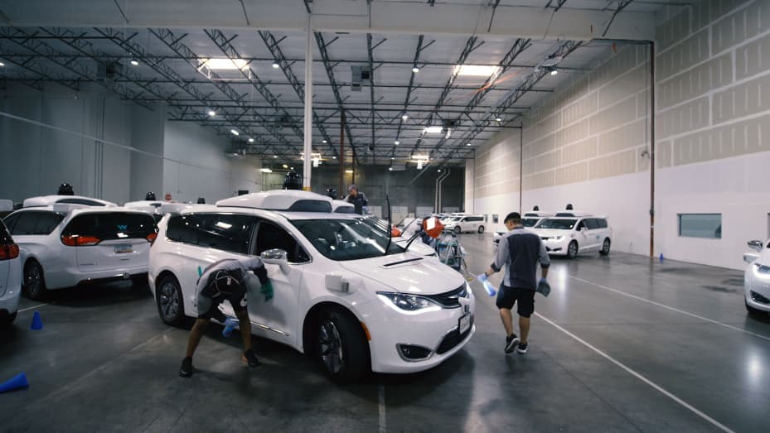
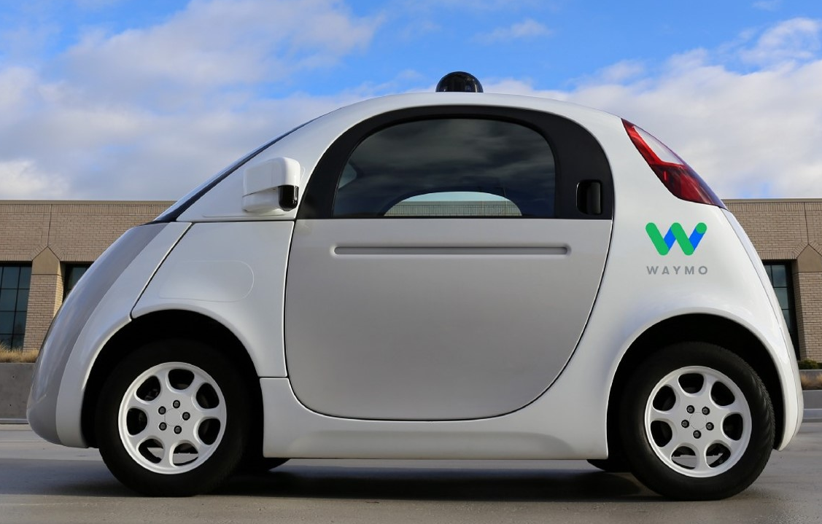
Artificial Intelligence Applications: Autonomous Vehicles
The development of autonomous vehicles will definitely revolutionaries the transport system.
The AI system collects data from the vehicles radar, cameras, GPS, and cloud services to produce control signals that operate the vehicle.
Advanced Deep Learning algorithms can accurately predict what objects in the vehicle‘s vicinity are likely to do. This makes Waymo cars more effective and safer.
Waymo, a division of Alphabet, became the first company to offer such a fleet to the public in late 2020. Waymo's service area is limited to a roughly 50-square-mile area in the Phoenix city.
Dexterous: having the ability to perform a difficult action quickly and skilfully with the hands
autoXChina
roverNasa

Slide 14

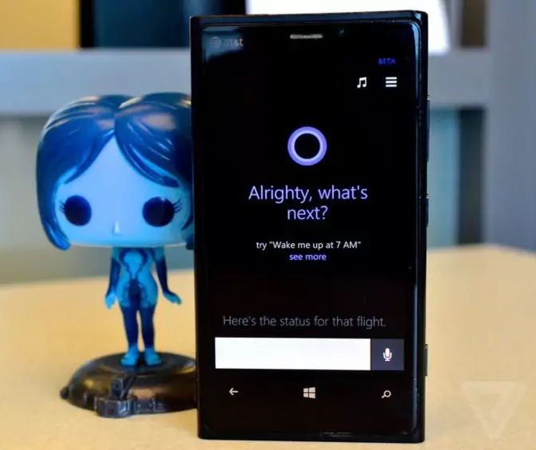
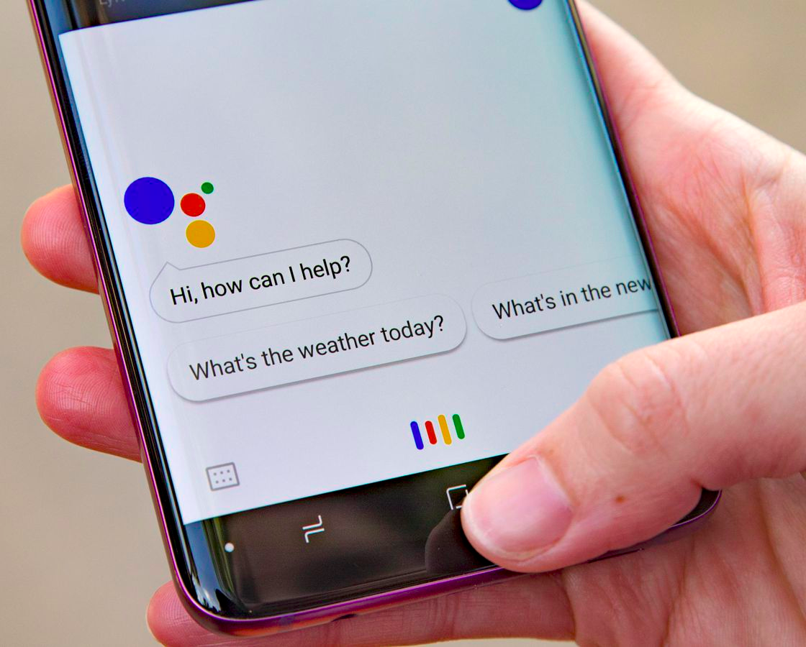
Artificial Intelligence Applications: Chatbots
AI chatbots can comprehend natural language and respond to people online who use the "live chat" feature that many organizations provide for customer service.
As AI continues to improve, these chatbots can effectively resolve customer issues, respond to simple inquiries, improve customer service, and provide 24/7 support.
Amazon‘s Echo is an example of how Artificial Intelligence can be used to translate human language into desirable actions.
It can do more than just play your favorite songs. It can be used to control the devices at your house, book cabs, make phone calls, order your favorite food, check the weather conditions and so on.
flippyRobot
amazonShopping
burgeRobot
burgeRobot
hopperAPP
cortana

Slide 15
Thanks
cesar.sinchiguano@uleam.edu.ec

Slide 16
https://www.simplilearn.com/tutorials/artificial-intelligence-tutorial/artificial-intelligence-applications
https://www.edureka.co/blog/artificial-intelligence-applications/
https://towardsdatascience.com/introducing-convolutional-neural-networks-in-deep-learning-400f9c3ad5e9
cesar.sinchiguano@uleam.edu.ec

